Slide 1

Introduction to Social Networks Analysis: Part 2
Melissa Whatley, Ph.D.
Belk Center for Community College Leadership and Research
North Carolina State University
Spring 2021

Slide 2
Part 2
Review of Centrality Measures
Degree Centrality
Closeness Centrality
Betweenness Centrality
Eigenvector Centrality
Peer Effects
Example
How-to in R

Slide 3
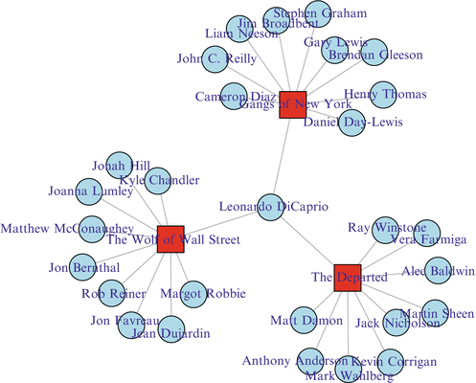
Basic Network Terminology
Actors/nodes/vertices
Ties/edges/links/lines
One-mode network
Two-mode network
Affiliation network

Slide 4
Centrality Measures
Degree Centrality
The number of ties that involve a given node
Closeness Centrality
How close a node is to the other nodes in a network
Betweenness Centrality
The number of times a node acts as a bridge between other nodes
Eigenvector Centrality
The extent to which a node is connected to other nodes that are important in a network

Slide 5
Centrality Measures
If this were an emergency preparation network and I needed to share a piece of information with the network quickly, who would I share the information with first?
If this were a political network and I wanted to leverage my connections for political influence, who would I want to be my friend?
If this were a crime network and I wanted to destroy as many connections in the network as possible, who would I remove?

Slide 6
Peer Effects

Slide 7
Peer Effects
More traditional forms of statistical analysis have been concerned with how to analyze data that are grouped
Fixed- and random-effects models (in econometrics)
Hierarchical linear modeling
Clustered standard errors
The main idea behind all these approaches is that the way that data are grouped matters
In network analysis, we can measure the extent to which grouping matters

Slide 8
Example Study: González Canché & Rios-Aguilar (2015)
Does the number of credits taken by a community college student’s classmates have any effect on the number of credits that student takes?
Data cleaning: Calculation of peer effects
Analysis: Regression

Slide 9
Data Structure: An Edgelist (One-mode or two-mode?)
Student ID | Course ID
1 | MAT120
1 | ENG111
1 | HIS101
2 | HIS231
2 | MAT120
2 | BIO104
2 | WRI100
3 | BIO104
3 | MAT120
… | …
N | N

Slide 10
Edgelist->(Incidence) Matrix
 | MAT120 | ENG111 | HIS101 | HIS231 | BIO104 | WRI100 | … | N
1 | 1 | 1 | 1 | 0 | 0 | 0 | … | …
2 | 1 | 0 | 0 | 1 | 1 | 1 | … | …
3 | 1 | 0 | 0 | 0 | 1 | 0 | … | …
.. | … | … | … | … | … | … | … | …
N | … | … | … | … | … | … | … | …

Slide 11

Transformation: Two-mode->One-mode
Matrix multiplication: $A∗A^{T}$
 | 1 | 2 | 3
MAT120 | 1 | 1 | 1
ENG111 | 1 | 0 | 0
HIS101 | 1 | 0 | 0
HIS231 | 0 | 1 | 0
BIO104 | 0 | 1 | 1
WRI100 | 0 | 1 | 0
 | MAT120 | ENG111 | HIS101 | HIS231 | BIO104 | WRI100
1 | 1 | 1 | 1 | 0 | 0 | 0
2 | 1 | 0 | 0 | 1 | 1 | 1
3 | 1 | 0 | 0 | 0 | 1 | 0

Slide 12

$$A∗A^{T}$$
Things to notice:
The diagonal is how many classes each student took
The off-diagonals tell us how many classes the students took together
 | Student 1 | Student 2 | Student 3 | … | N
Student 1 | 3 | 1 | 1 | … | …
Student 2 | 1 | 4 | 2 | … | …
Student 3 | 1 | 2 | 2 | … | …
… | … | … | … | … | …
N | … | … | … | … | …

Slide 13
More Matrix Manipulation
We know that a student took a class with themselves - what we care about are the student’s peers
So, we make the diagonal = 0
We add an attribute for the number of credits (N classes * 3) to the matrix
 | Student 1 | Student 2 | Student 3 | … | N | Credits
Student 1 | 0 | 1 | 1 | … | … | 9
Student 2 | 1 | 0 | 2 | … | … | 12
Student 3 | 1 | 2 | 0 | … | … | 6
… | … | … | … | … | … | …
N | … | … | … | … | … | …

Slide 14
More Matrix Manipulation
 | Student 1 | Student 2 | Student 3 | N Credits | N Classmates
Student 1 | 0 | 9 | 9 | 9 | 2
Student 2 | 12 | 0 | 12 | 12 | 2
Student 3 | 6 | 6 | 0 | 6 | 2
Peer Credits | 18 | 15 | 21 | … | …

Slide 15
More Matrix Manipulation
 | Student 1 | Student 2 | Student 3 | N Crdts | N Classmtes | Peer Credits | Peer Effect
Student 1 | 0 | 9 | 9 | 9 | 2 | 18 | 18/2=9
Student 2 | 12 | 0 | 12 | 12 | 2 | 15 | 15/2=7.5
Student 3 | 6 | 6 | 0 | 6 | 2 | 21 | 21/2=10.5
Peer Credits | 18 | 15 | 21 | … | … | … | …

Slide 16
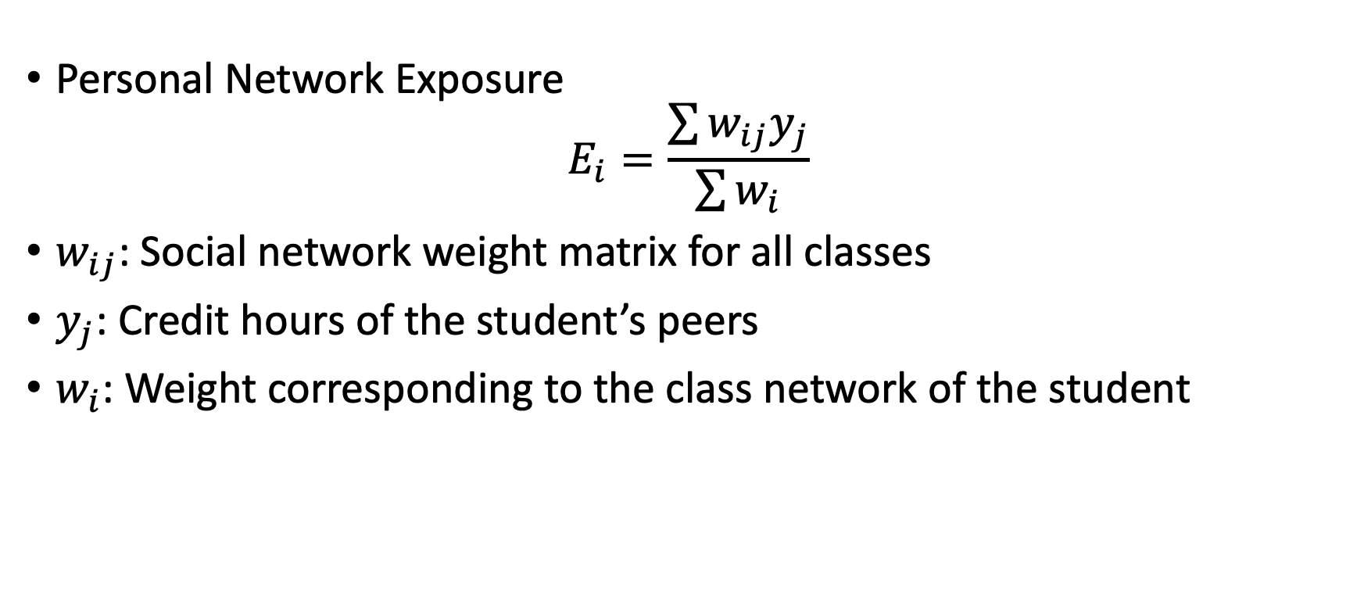
Formal Notation (Valente, 2005)
Personal Network Exposure
$$E_{i}=\frac{\sum{w_{ij}y_{j}}}{\sum{w_{i}}}$$
$w_{ij}$: Social network weight matrix for all classes
$y_{j}$: Credit hours of the student’s peers
$w_{i}$: Weight corresponding to the class network of the student

Slide 17
Analysis
You can enter in the calculated peer effect into whatever statistical model you want.
In this example, we’ll use linear regression.

Slide 18
Suggested Reading
González Canché, M.S., & Rios-Aguilar, C. (2015). Critical social network analysis in community colleges: Peer effects and credit attainment. New Directions for Institutional Research, 163, 75-91.
Luke, D.A. (2015). A User’s Guide to Network Analysis in R. Springer.
Valente, T.W. (2005). Network models and methods for studying diffusion of innovations. in P.J. Carrington, J. Scott, & S. Wasserman (Eds.), Models and methods in social network analysis (pp. 98-116). Cambridge University Press.
Next time: Network Analysis of Qualitative Data

Slide 19
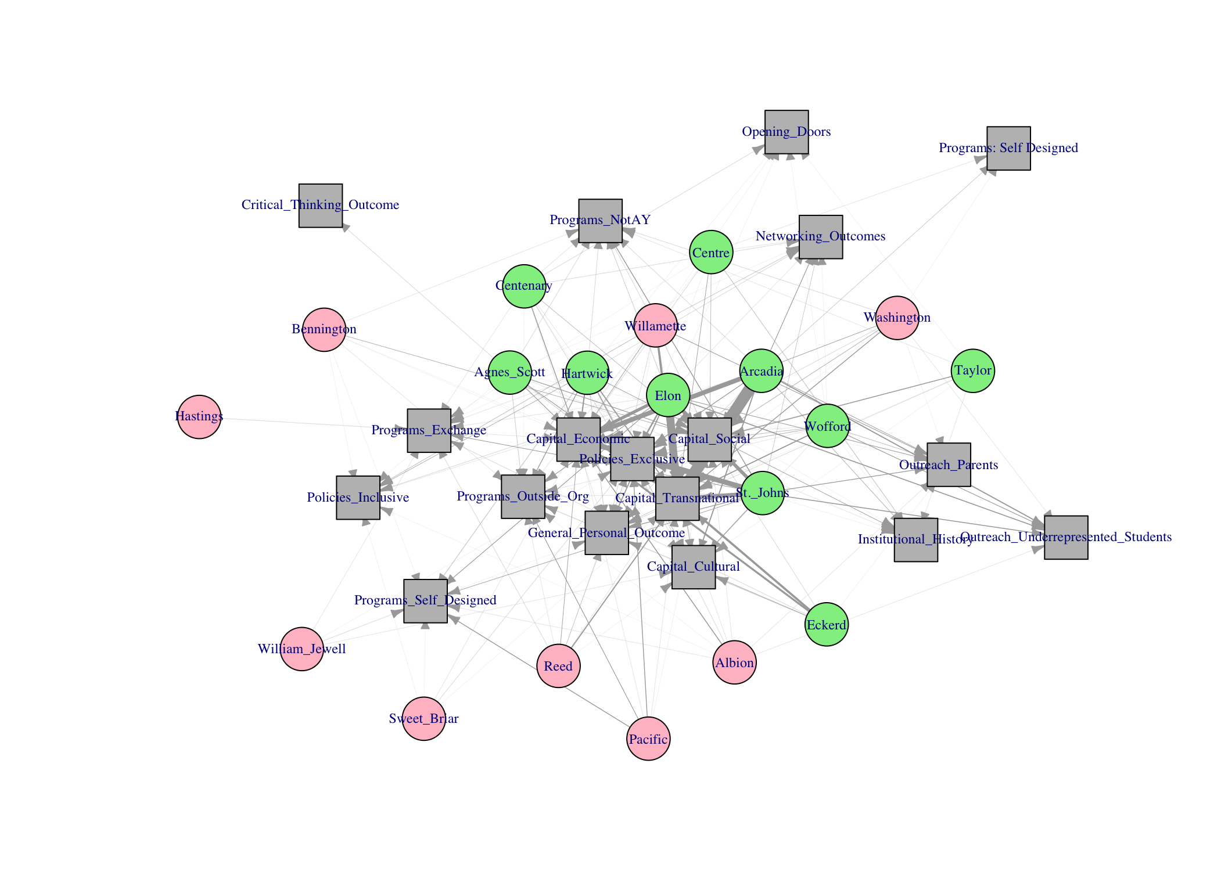
Example of Qualitative Data Network

